Slide 1
Crown Identification
Tushar Kulkarni
Machine Learning Engineer Intern
Master of Science Student at UC Irvine
Mentors Sergei Azernikov, Andrey Gubenko, Chih-Chun Lin

Slide 2
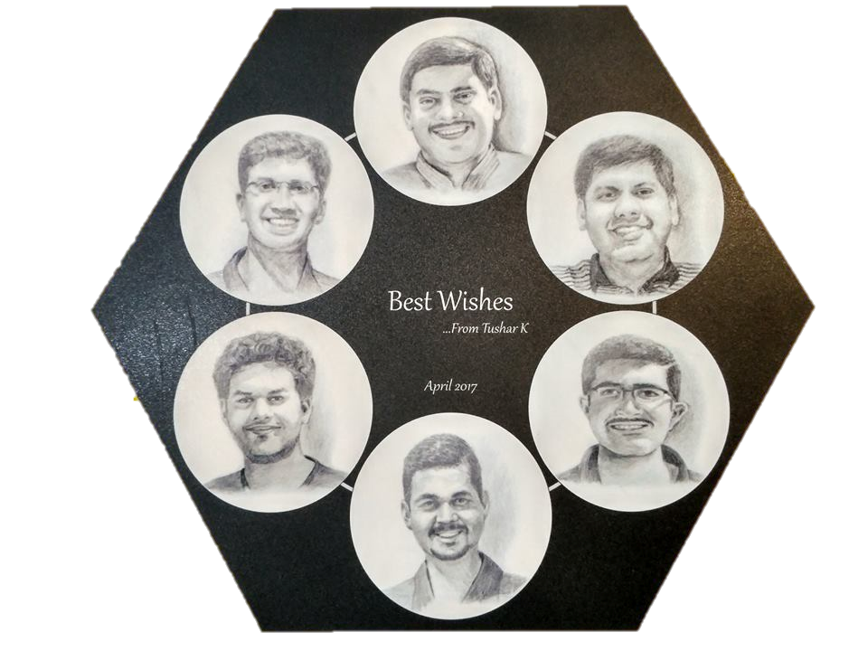
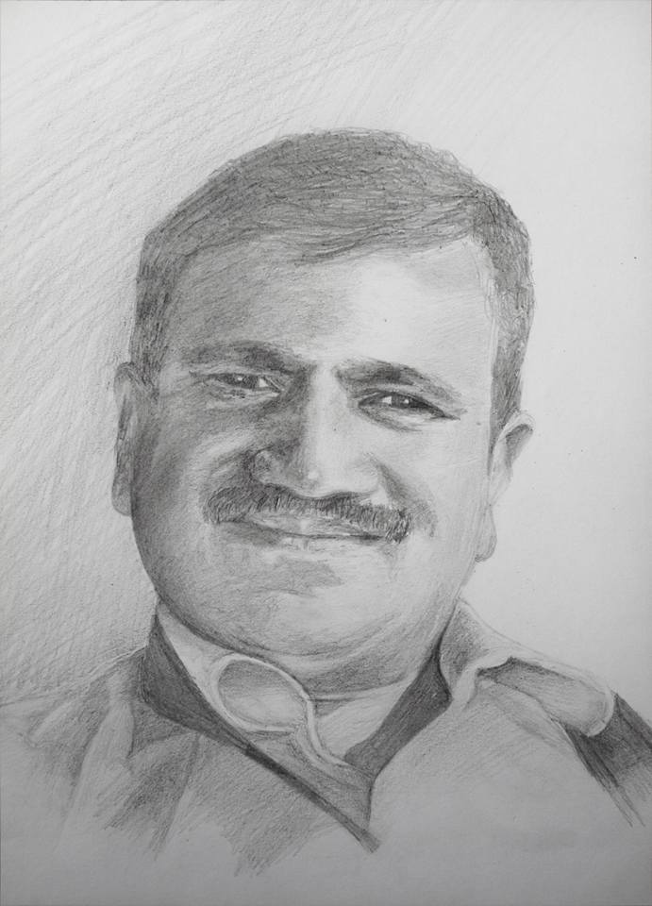
Interesting facts about me?
Well… let’s see
75% - 80% introvert
Designing
Sketching, Drawing, Painting
Playing tennis for >12 years
Cooking
Photography
Travelling, Hiking
Books
Computer Science
Notes:
Interesting facts?
I am an introvert
I love designing, sketching, painting
I like photography, Travelling, Hiking
I cannot live without books

Slide 3
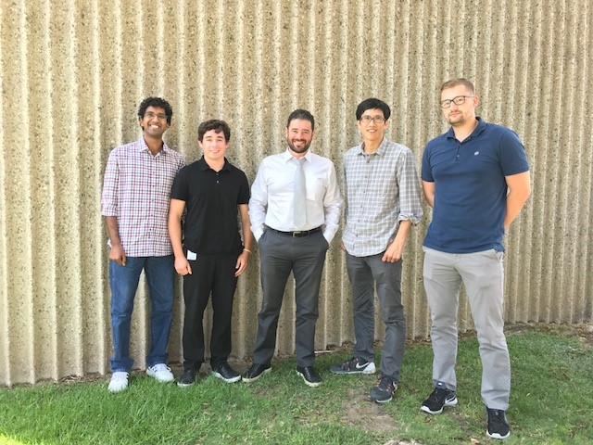
My Team – Machine Learning
Credits: Gavin Goddard

Slide 4
Some things I can’t explain right now…
Due to time limitation
…I will refer to them as Magic!

Slide 5
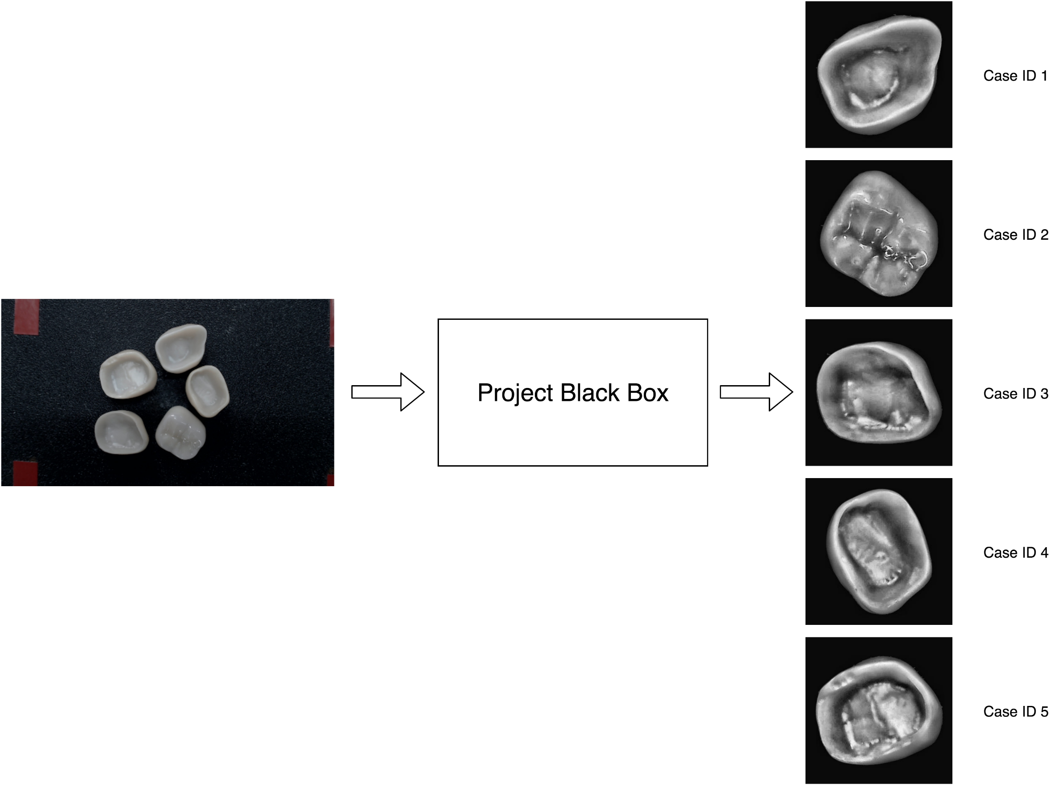
Black Box Representation

Slide 6
Why do we need this system?
Fast identification of unknown crowns
No dependency over other external identification methods e.g. Barcode, RFID, Text Labels
Why Machine Learning and Computer Vision?
Removes redundant information e.g. color, contrast, perspective, lighting (to certain extent)
Recognizes patterns in crown rather than actual crown (features)

Slide 7
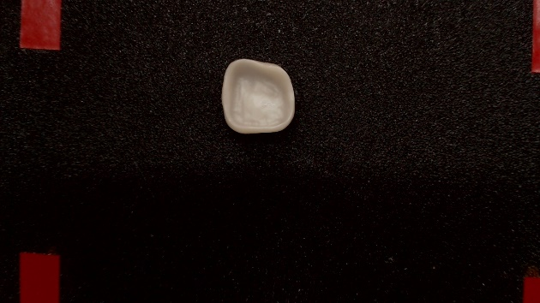
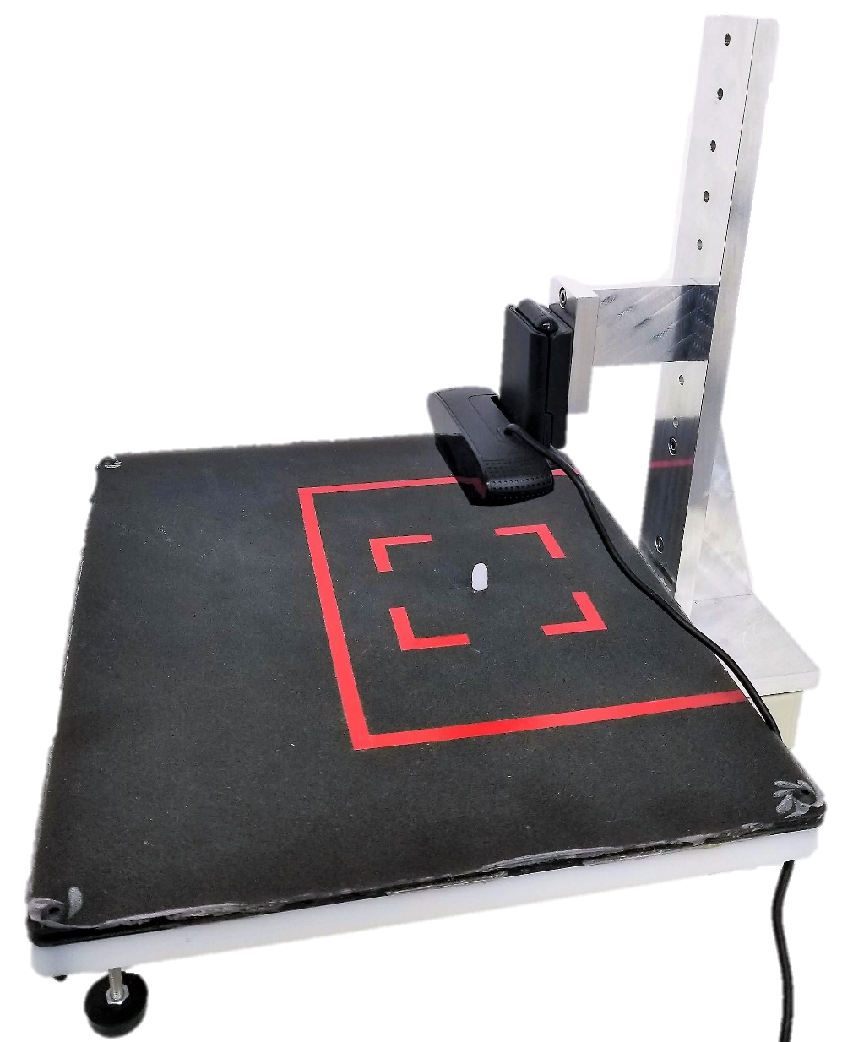
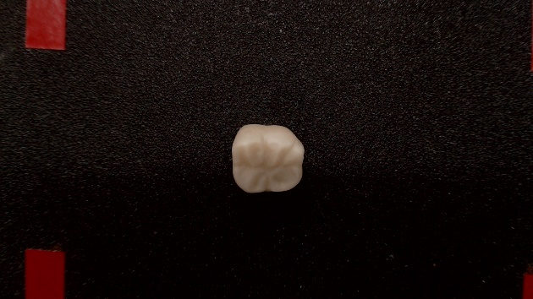
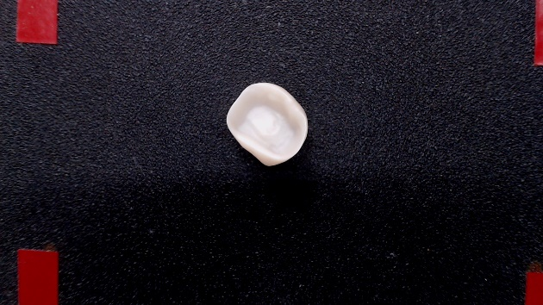
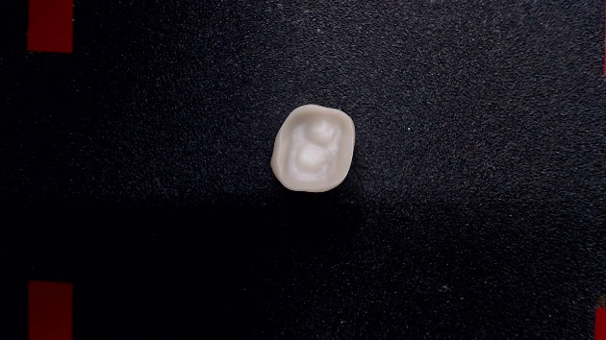
Crown Identification
Project of Andrey Gubenko

Slide 8
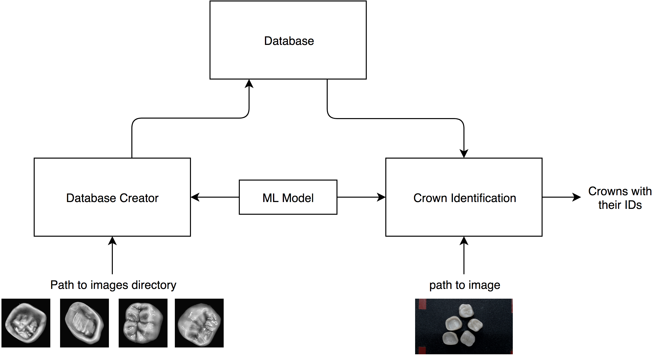

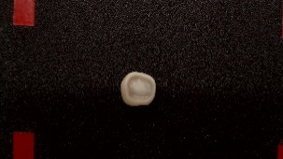
Crown Identification
Block Diagram
A lot of magic happens here…
Keras

Slide 9
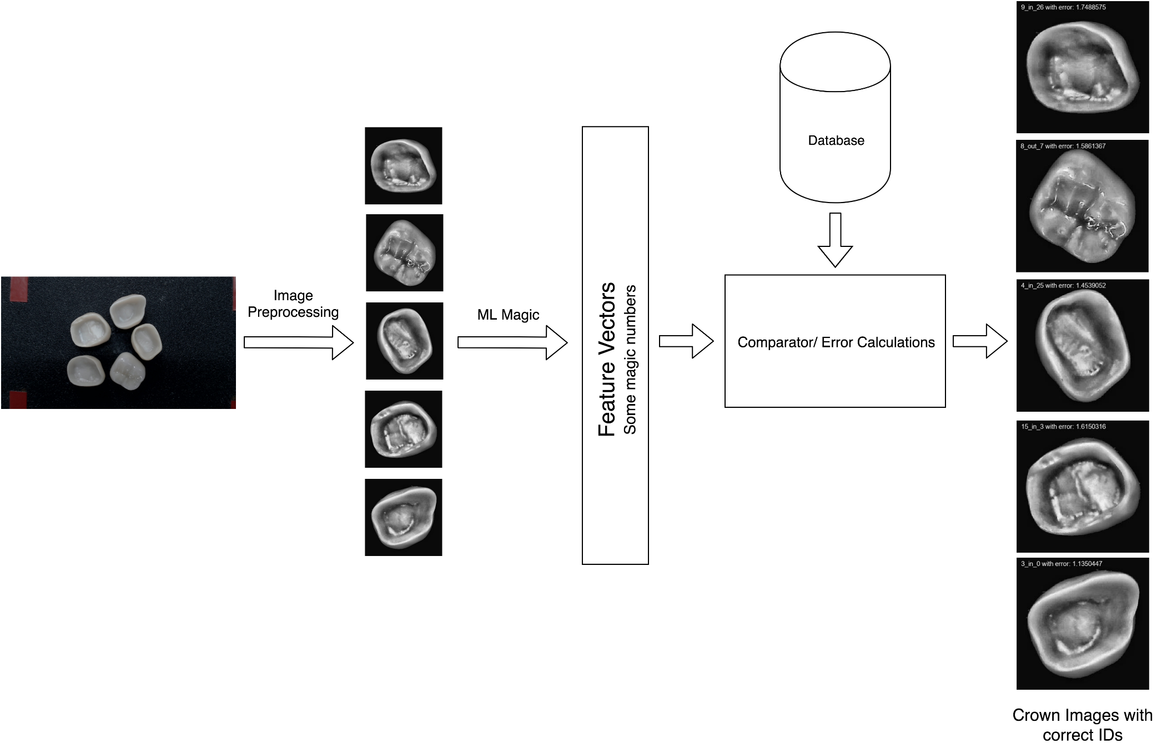
Crown Identification

Slide 10
Let’s look at a demo
Notes:
Demo

Slide 11
What I learned?
Teamwork and individual contribution
Practical application of my knowledge
Deal with undesirable factors that makes the system unstable
Worked from data collection stage to deployment ready system stage
Notes:
Demo

Slide 12
Thank you

